Slide 1
Customer Churn Prediction
Using KNIME
Monish Jayaprakash Seelam – MJS230000
Rupak Manikonda – RXM230010
Ulchala Vikas Kumar Reddy – VXU230003

Slide 2
Setting the Stage:
Purpose and Data
Foundation
Objective
Predict which customers are likely to churn.
Identify key drivers of churn for actionable insights
Dataset
Telco Customer Churn dataset - https://www.kaggle.com/datasets/blastchar/telco-customer-churn
7032 customer records, 60 features after preprocessing
Features include tenure, contract type, monthly charges, internet service, etc.

Slide 3
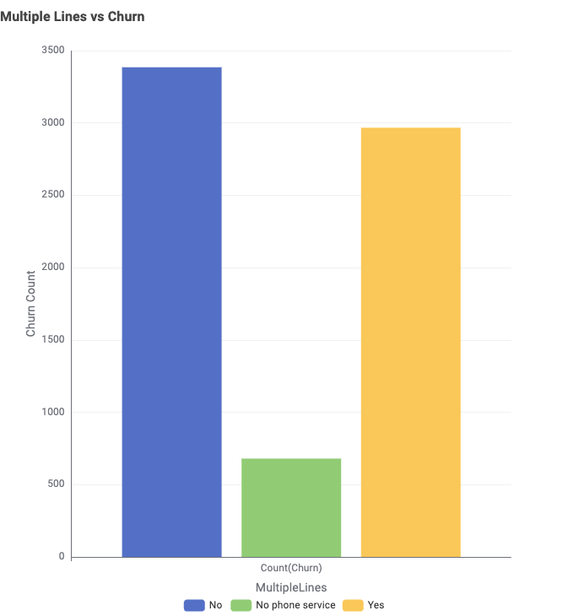
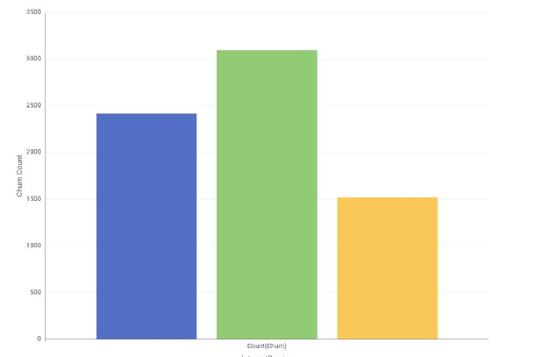
Uncovering Patterns: What the Data Reveals
Most churned customers have tenure < 10 months
Customers with high monthly charges are more likely to churn
Month-to-month contracts show higher churn risk
New feature tenure_to_total_ratio helps distinguish low-commitment high-cost customers
Multiple Lines vs Churn
No
Internet Service vs Churn
No phone service
Yes
DSL
Fiber Optic
No

Slide 4
Bringing Insights to Life Through Visuals

Slide 5
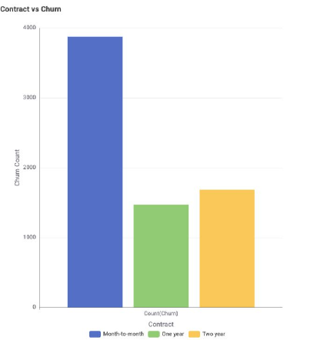
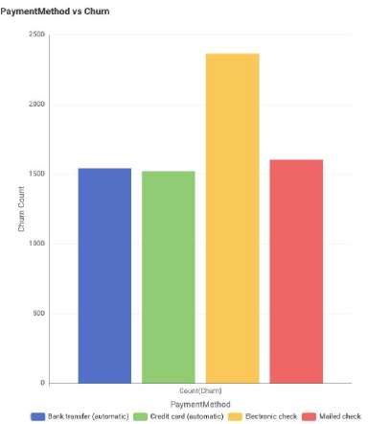
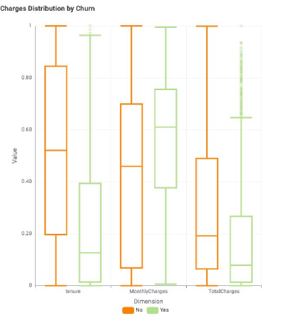
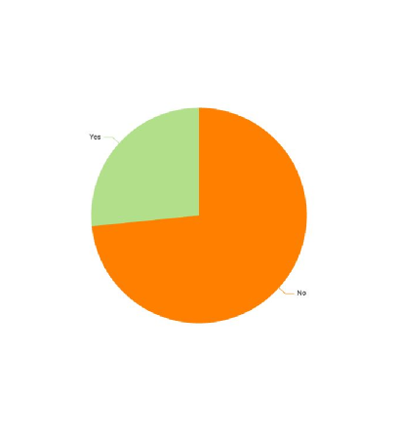
Contract Type vs Churn
Payment Method vs Churn
Charges Distribution by
Churns
Churn Category
Month-to-month contracts show the highest churn, while churn is significantly lower for 1-year and 2-year contracts.
Customers paying via electronic check show the highest churn, suggesting potential dissatisfaction or disengagement with that payment mode.
Churned customers generally have lower tenure and total charges but slightly higher monthly charges, indicating early dropout despite paying more per month.
Approximately 26% of customers have churned, highlighting a significant minority at risk that warrants focused retention efforts.

Slide 6
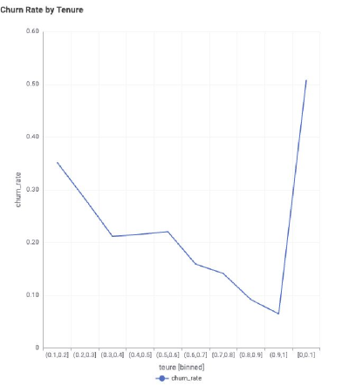
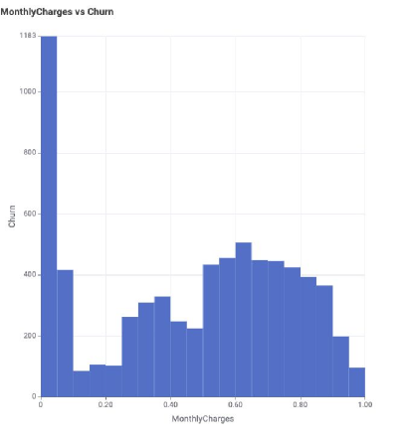
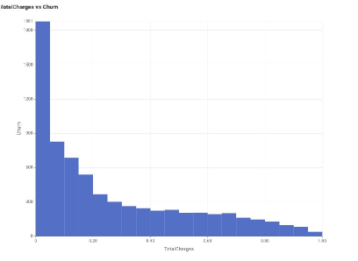
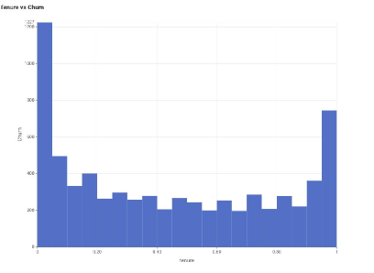
Contract Type vs Churn
Total Charges vs Churn
Tenure vs Churn
Monthly Charges vs Churn
Month-to-month contracts show the highest churn, while churn is significantly lower for 1-year and 2-year contracts.
Churn is heavily concentrated among customers with low total charges, likely due to their short relationship with the service.
Churn is highest among customers with the shortest tenure, emphasizing the need for early-stage engagement.
Customers with moderate to high monthly charges experience greater churn, indicating potential dissatisfaction with pricing.

Slide 7
Evaluating Performance: Which Model Wins?
Model | Recall (Yes) | Precision | F1 (Yes) | Cohen's Kappa
Logistic Regression | 0.646 | 0.494 | 0.560 | 0.428
Random Forest | 0.415 | 0.683 | 0.517 | 0.395
XGBoost | 0.515 | 0.631 | 0.567 | 0.431

Slide 8
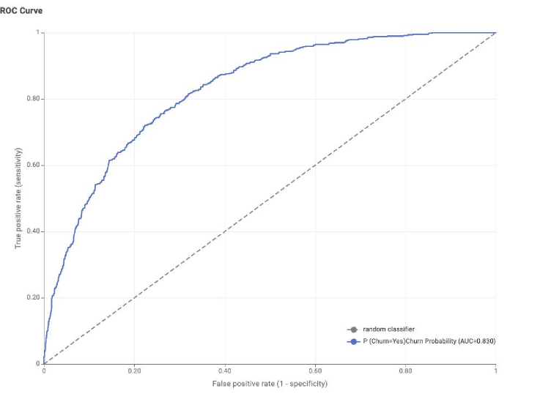
Top Performer
XGBoost in Action
Why XGBoost?
Best Cohen's Kappa (0.431) — strongest class agreement
Balanced Recall & Precision
Higher F1-Score than other models
Deployed for churn prediction due to its balance between catching churners and minimizing false positives

Slide 9
Decoding Churn
What the Model Tells Us
Top Features Driving Churn
Tenure – Short tenure = high churn risk
Contract Type – Month-to-month contracts linked to higher churn
Monthly Charges – High monthly charges increase churn likelihood
Total Charges – Low total charges = newer, more likely to churn
Payment Method – Electronic check users churn more than others
Internet Service – Fiber optic users churn more than DSL users
What the Model Reveals
Churn is highest in early-tenure customers (<10 months)
Customers with high monthly charges but low total charges are at risk
Month-to-month contracts are a major churn driver
Payment behavior and service type also influence churn likelihood
The model enables early identification and segmentation of high-risk customers

Slide 10
From Insights to Actions
Strategic Takeaways
Engage New Customers Early
Adjust Pricing Strategy for High-Paying Customers
Customers with tenure < 10 months have the highest churn risk.
High MonthlyCharges are associated with increased churn.
Offer customizable or discounted bundles to high-paying users to improve perceived value.
Launch onboarding programs and early-stage loyalty offers within the first 3–6 months.
Incentivize Long-Term Contracts
Target Short Tenure + High Charge Segment
Month-to-month customers are more likely to churn.
This is the most vulnerable group.
Incentivize annual or 2-year contracts with discounts or loyalty rewards.
Create retention campaigns with exclusive benefits for customers with low tenure and high bills.

Slide 11
Thank You

